Slide 1
Runnels County Town Hall Meeting
Jail Repairs / Bond Election

Slide 2
Runnels County Officials
Julia Miller County Judge
Carl King Commissioner, Precinct 1
Chris Ocker Commissioner, Precinct 2
Brandon Poehls Commissioner, Precinct 3
Juan Ornelas Commissioner, Precinct 4
Carl Squyres County Sheriff

Slide 3
Architects / Financial Services
Kenny Burns – Burns Architecture LLC
Kye Franke – KFW Architects, AIA
Paul Jasin – Specialized Public Finance Inc.

Slide 4
What have we been up to?
November 2023 - Jail Commission shut down the county jail due to mold issues.
Mold remediation – clean up only. Purchased dehumidifiers to temporarily resolve the reoccurrence of mold.
Replaced one AC unit (12 units remaining to be replaced).
Sewer smell has been temporarily addressed (Cast iron & copper plumbing issues within the walls yet to be addressed.)
Replaced cameras due to safety & security concerns (Need additional cameras).
Replaced generator & transfer switches.
Currently replacing exterior due to water intrusion from hail damage.
Upgraded control board (electronics only) for all cell doors and intercoms into each cell (Sliding cell doors yet to be addressed).
Purchased a transport van.
Hired full time maintenance person.
Expended $1,119.992 on repairs since 2022.

Slide 5
Remaining Jail Repairs
The following is a partial list of some of the work that may be undertaken in connection with the financed project.
⬥ Fire Alarm System  Water Sewer Improvements  Thermostats  HVAC and Dehumidifiers  Lighting  Jail Doors  Intake restroom upgraded to ADA accessible  Security - cameras  Security - perimeter

Slide 6
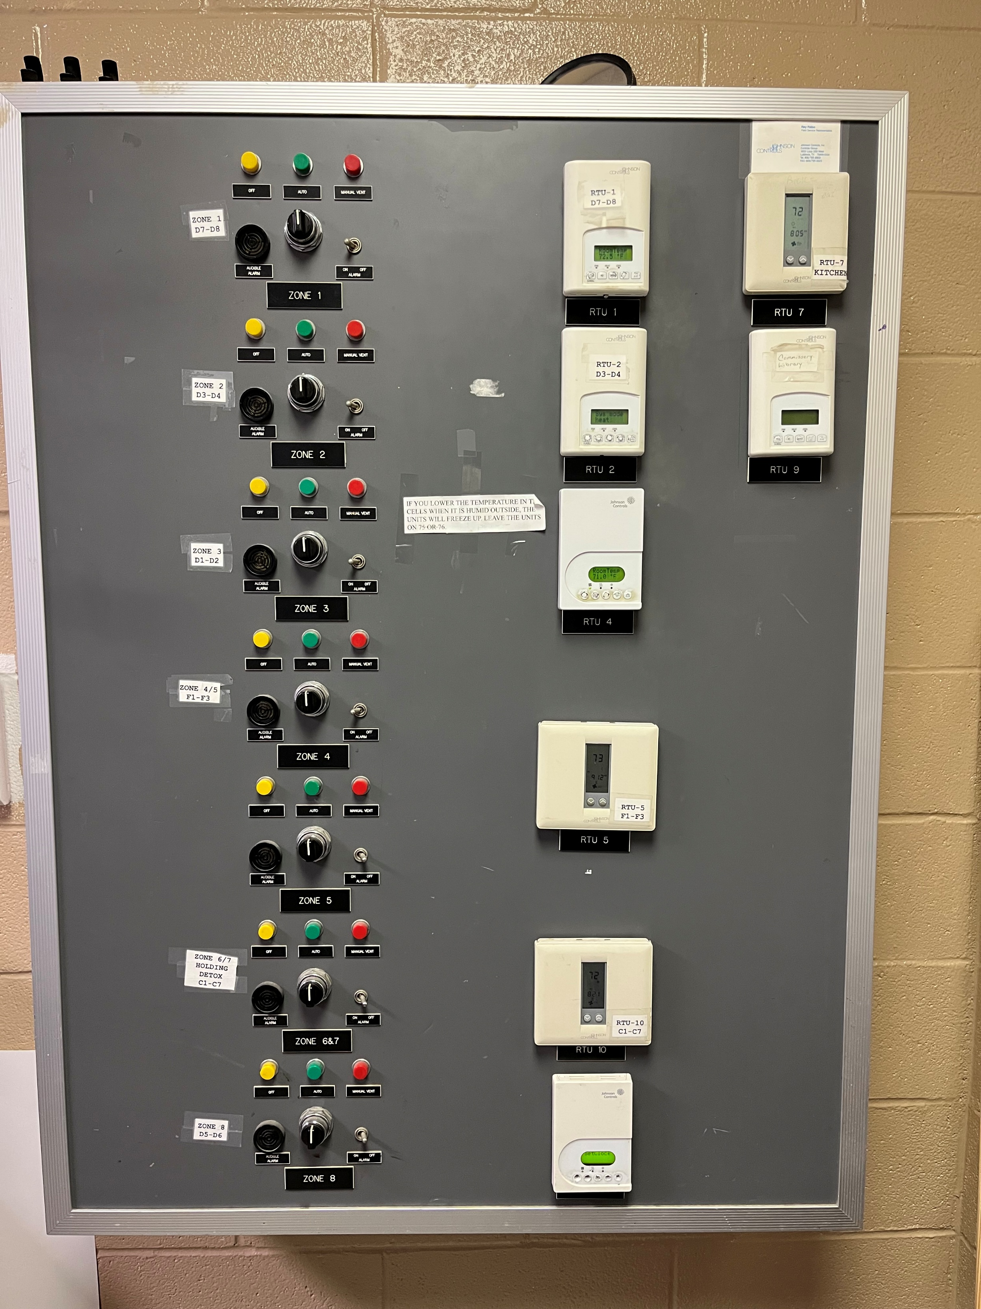
CONTROL PANEL for
HVAC System and Fire Suppression
Entire system to be replaced.

Slide 7
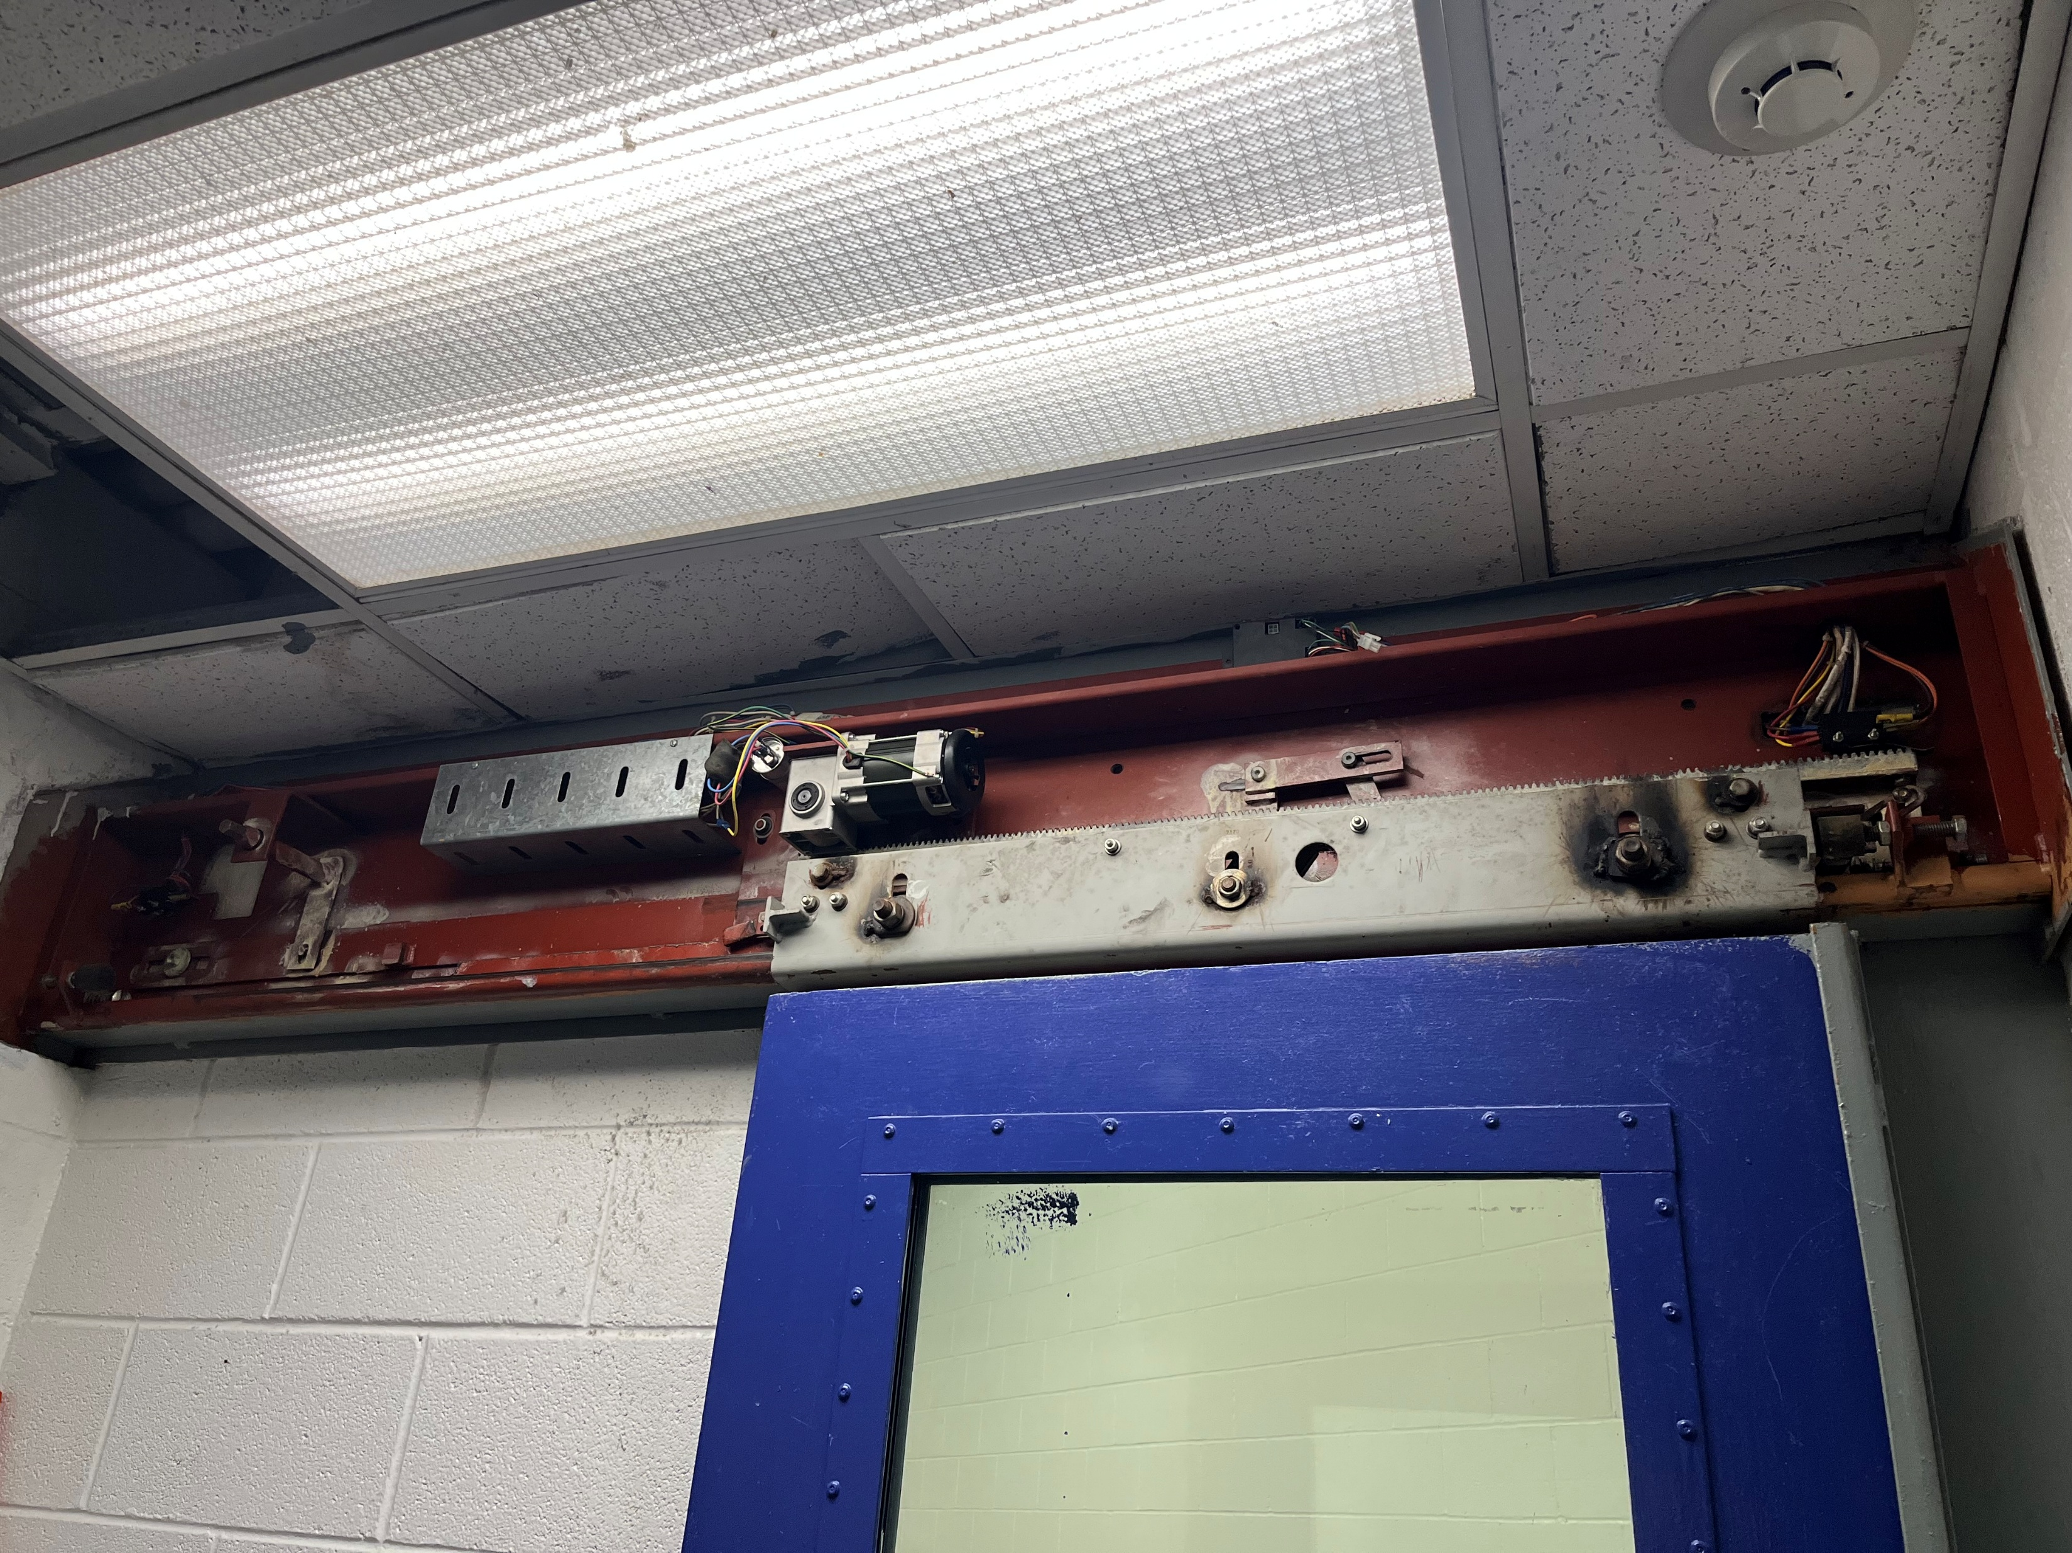
SLIDING DOORS
Due to constant wear, all sliding doors to be replaced with swinging doors.

Slide 8
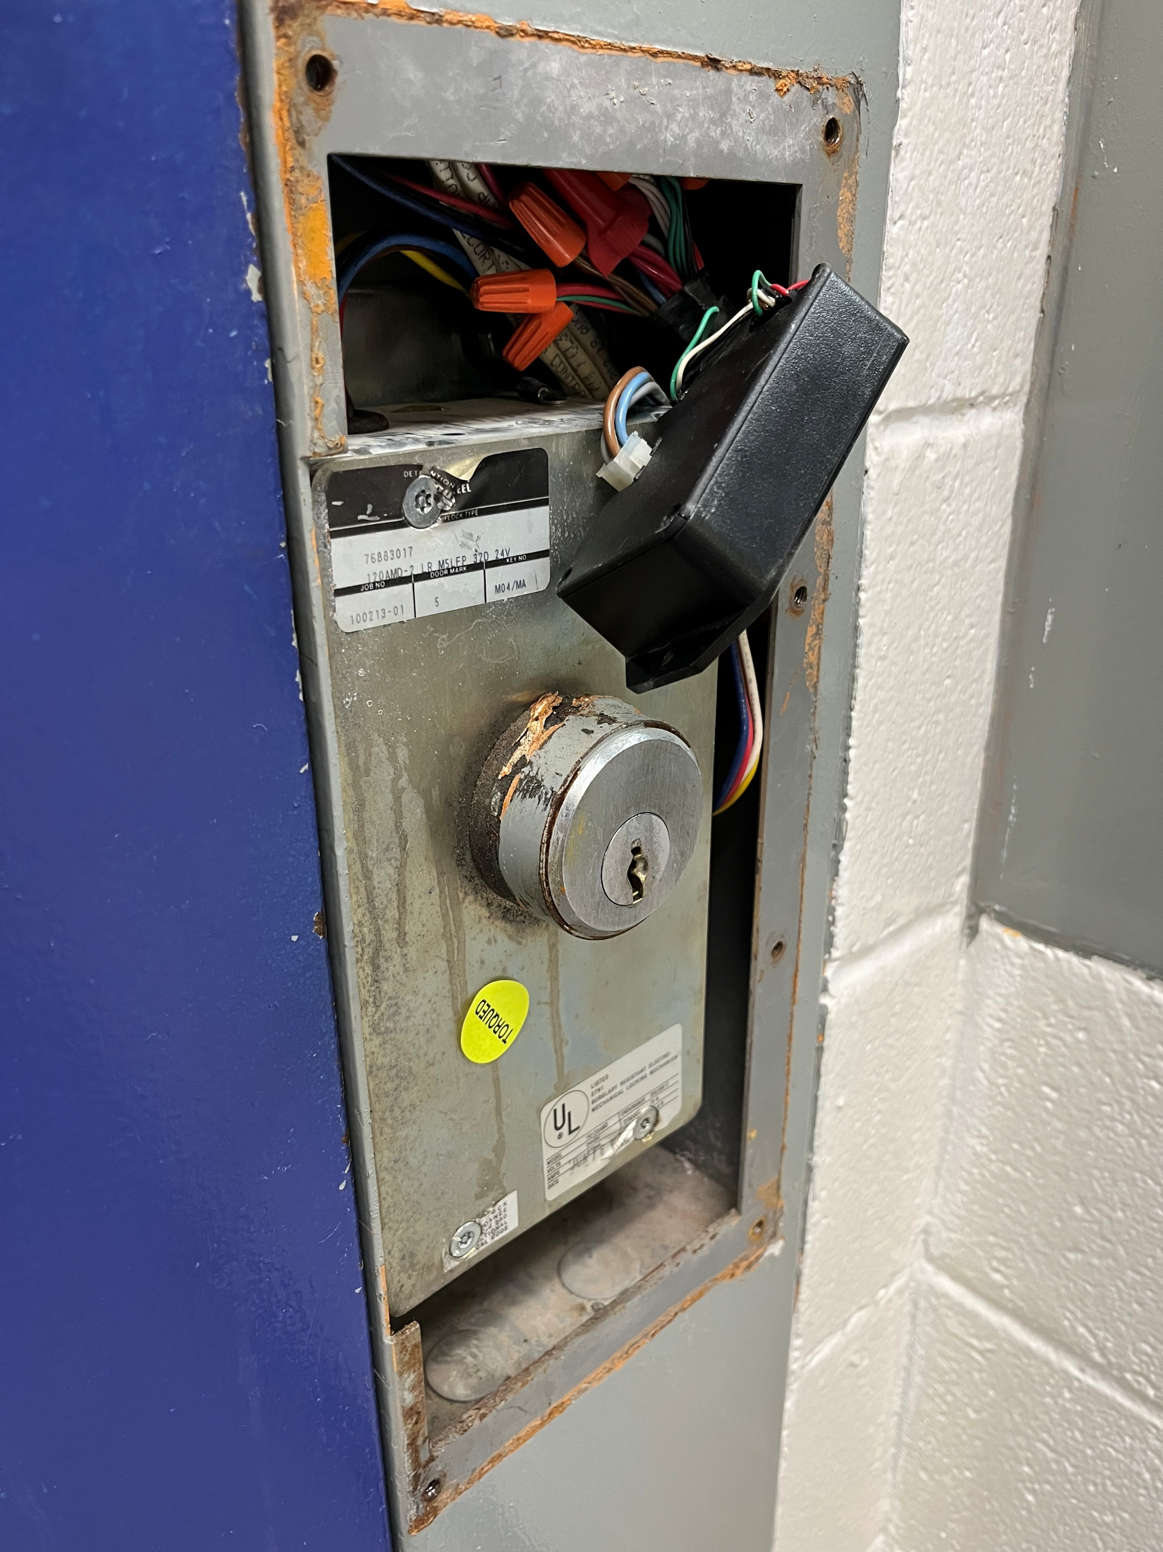
CELL DOOR Inadequate security / safety.

Slide 9
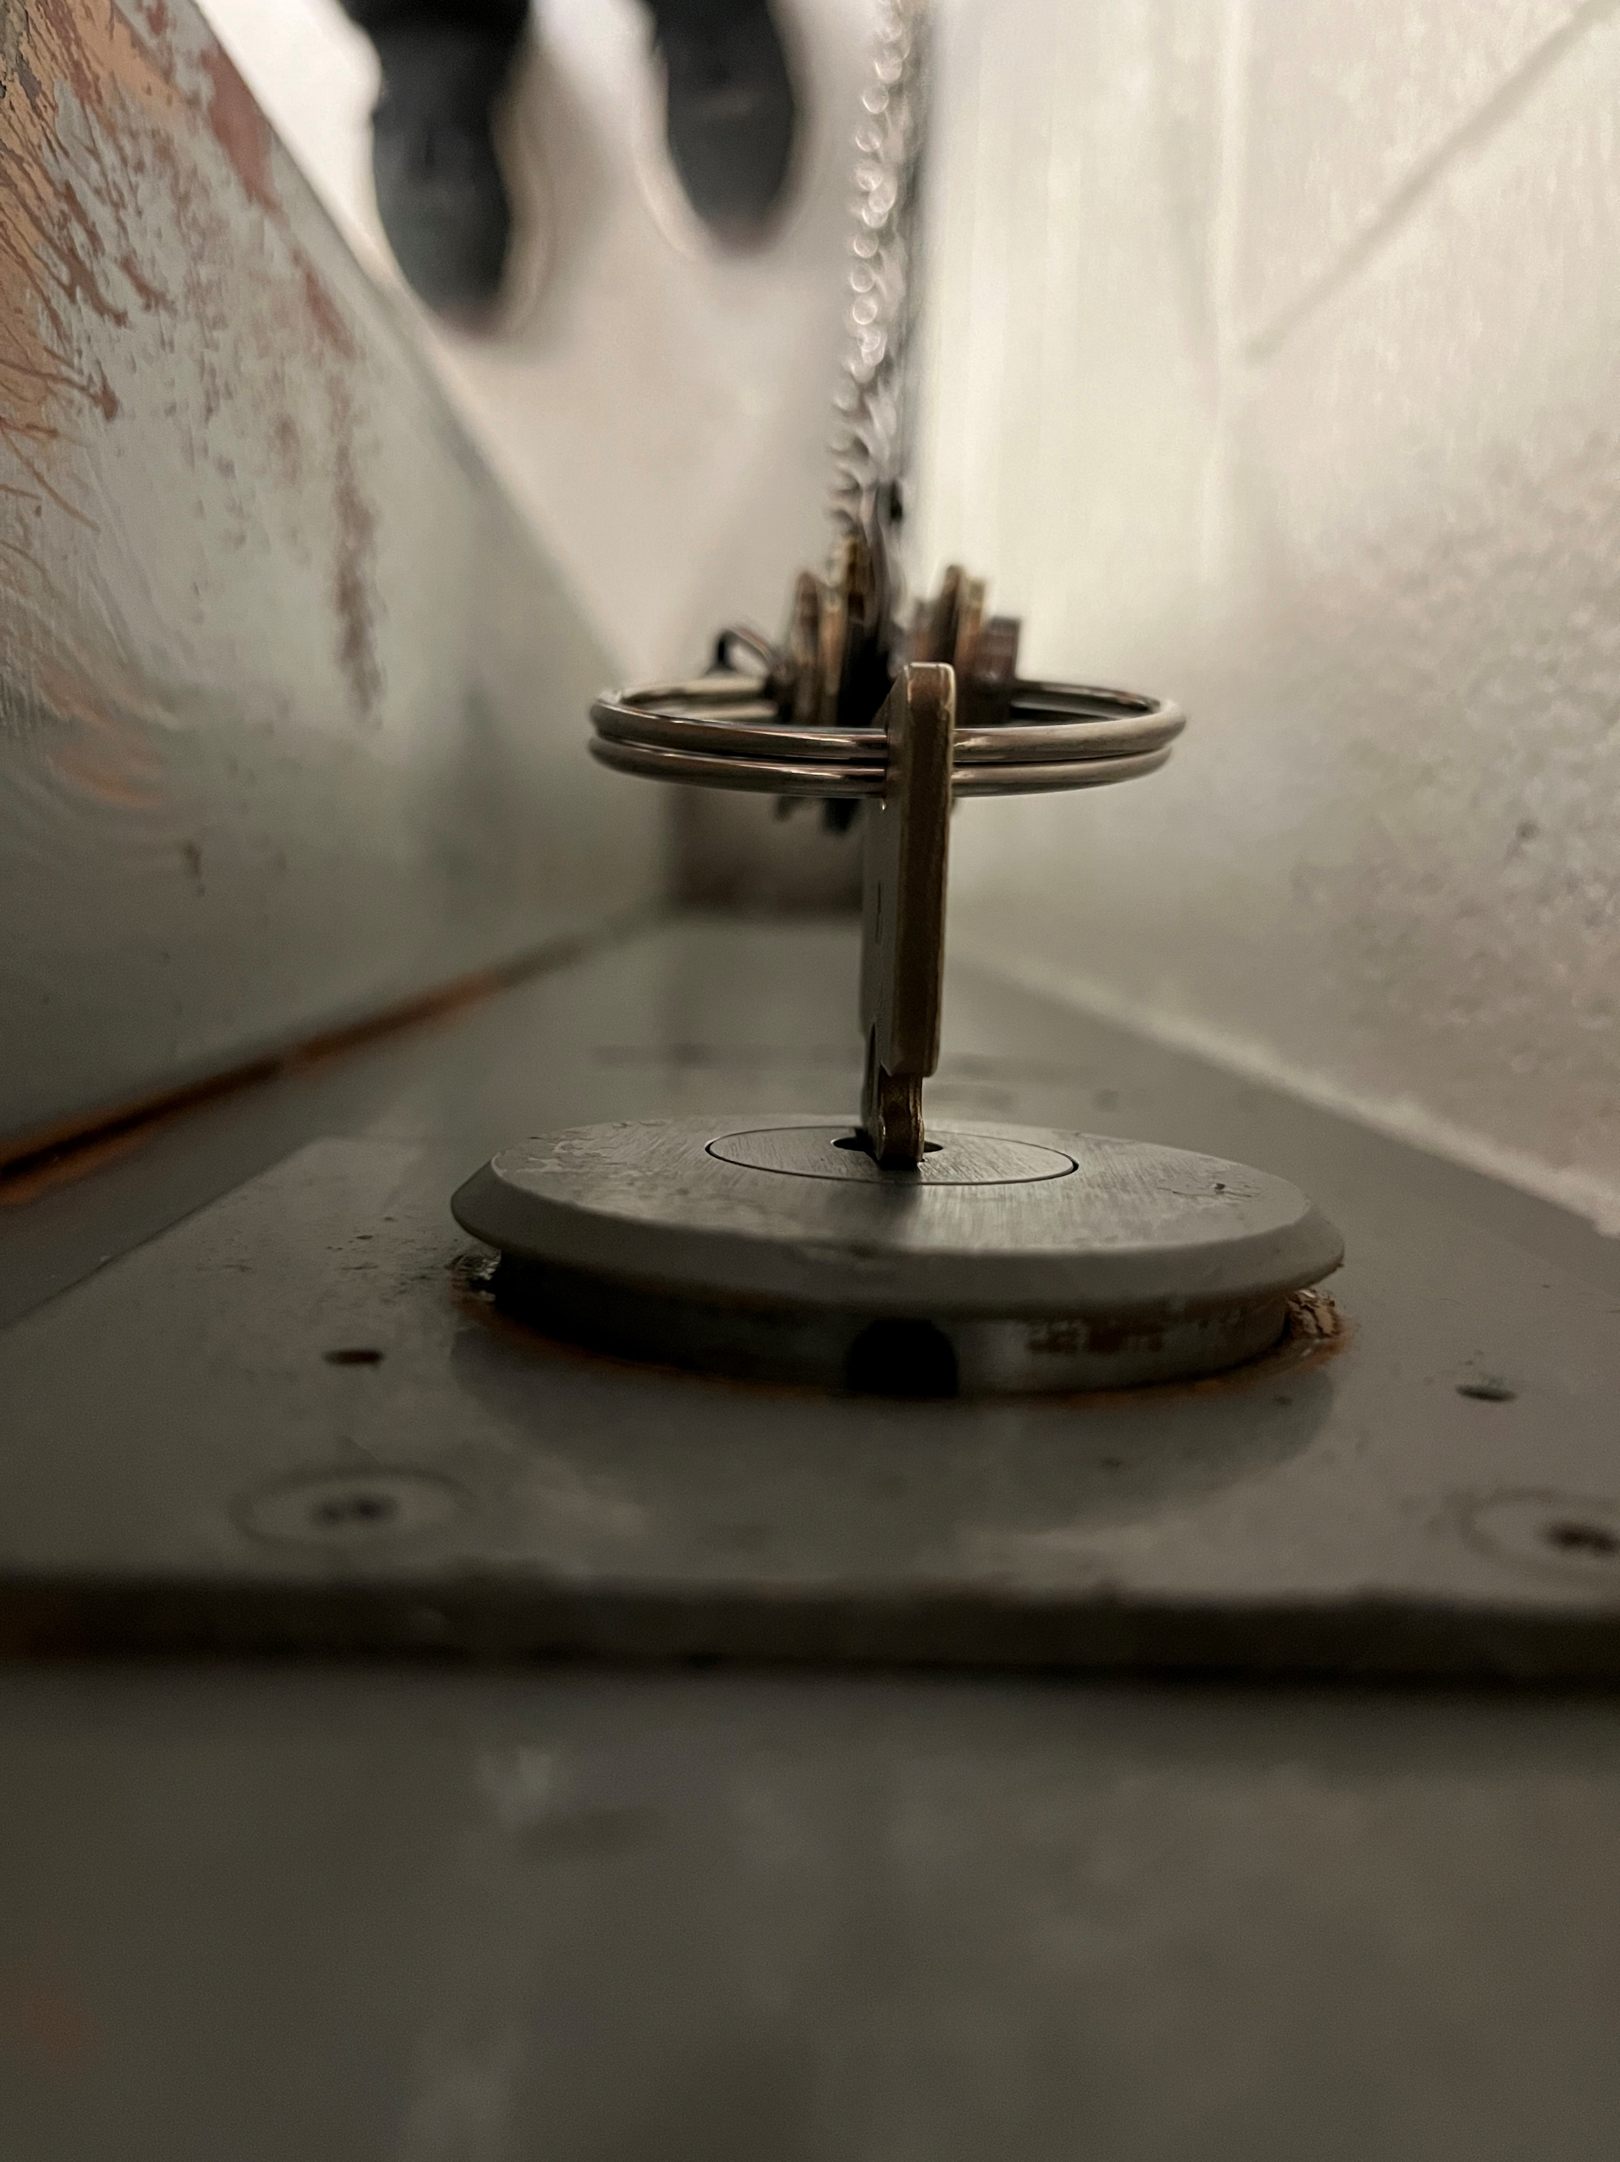
CELL DOOR (locking mechanism) Inadequate security / safety.

Slide 10
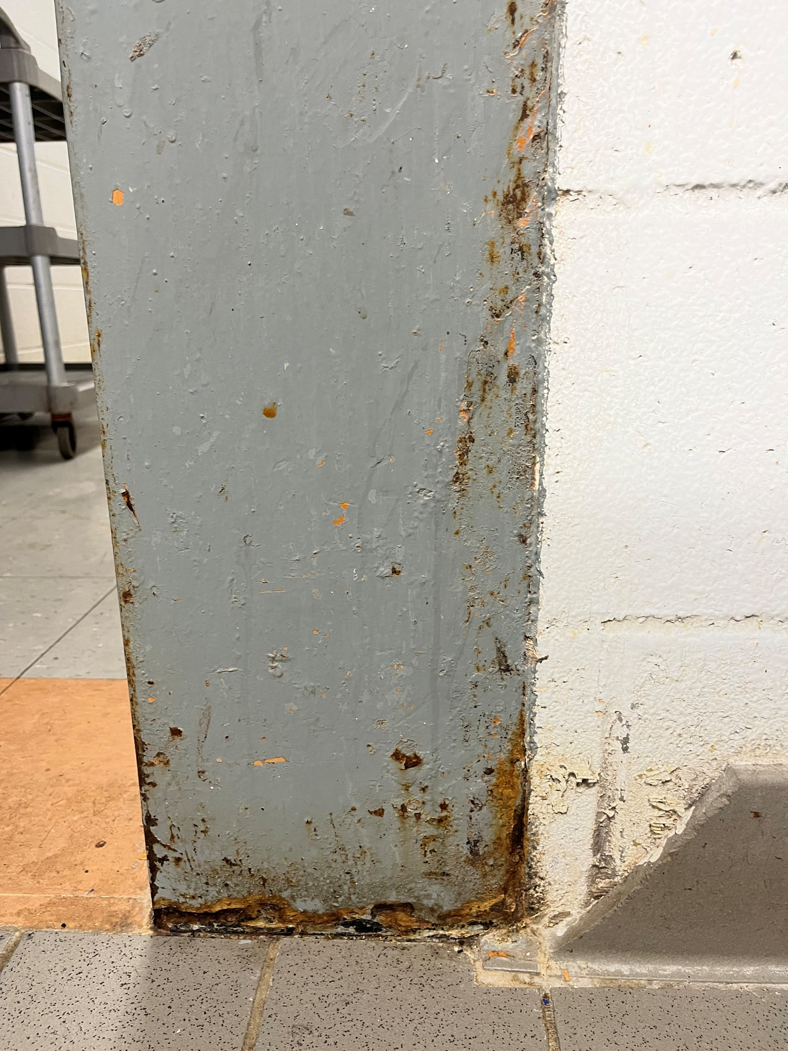
CELL DOOR FRAME
To be repaired

Slide 11
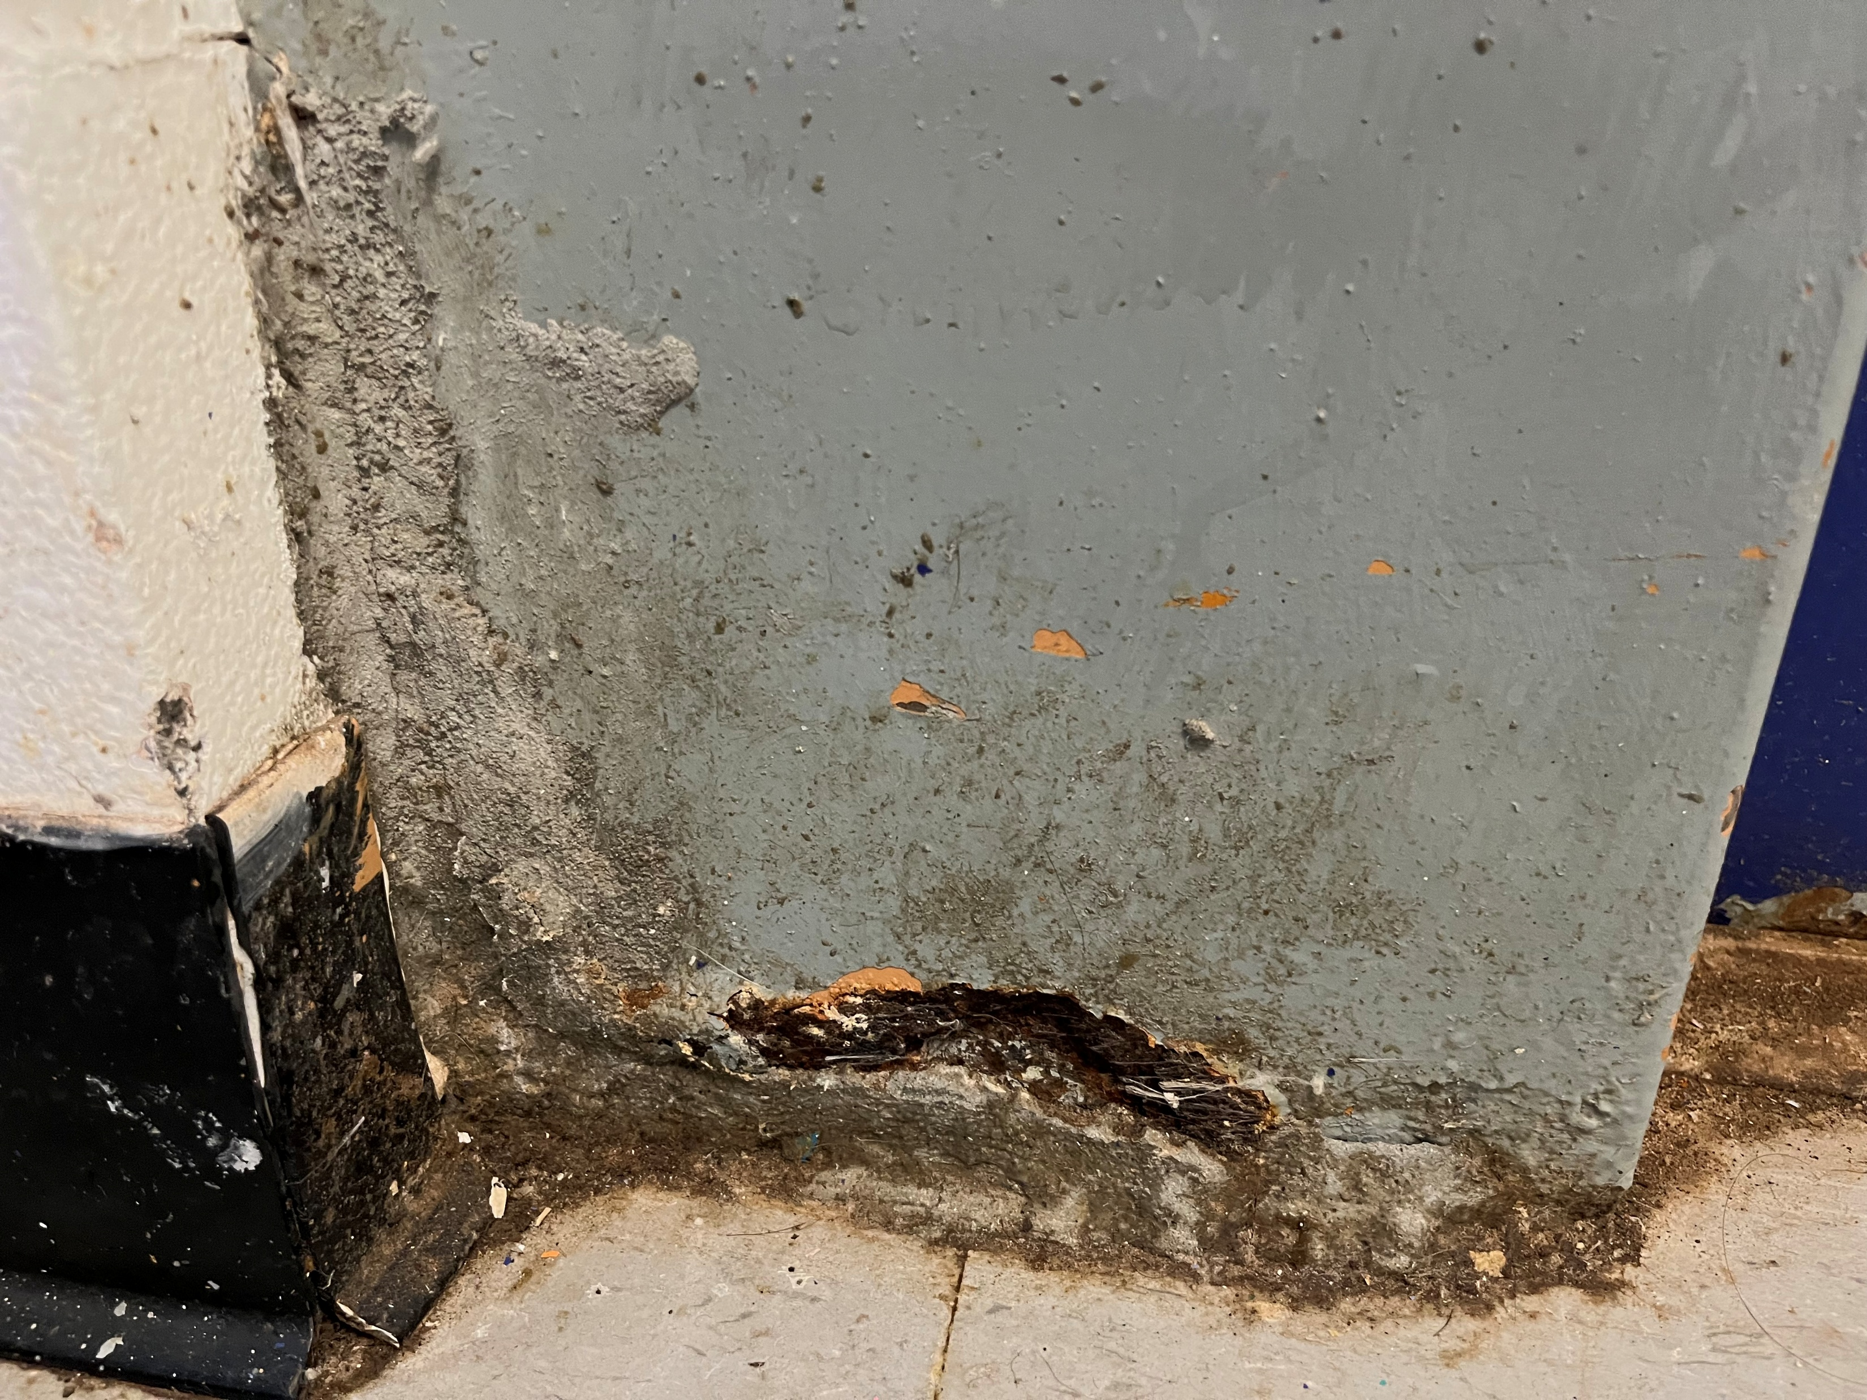
CELL DOOR FRAME
To be repaired

Slide 12
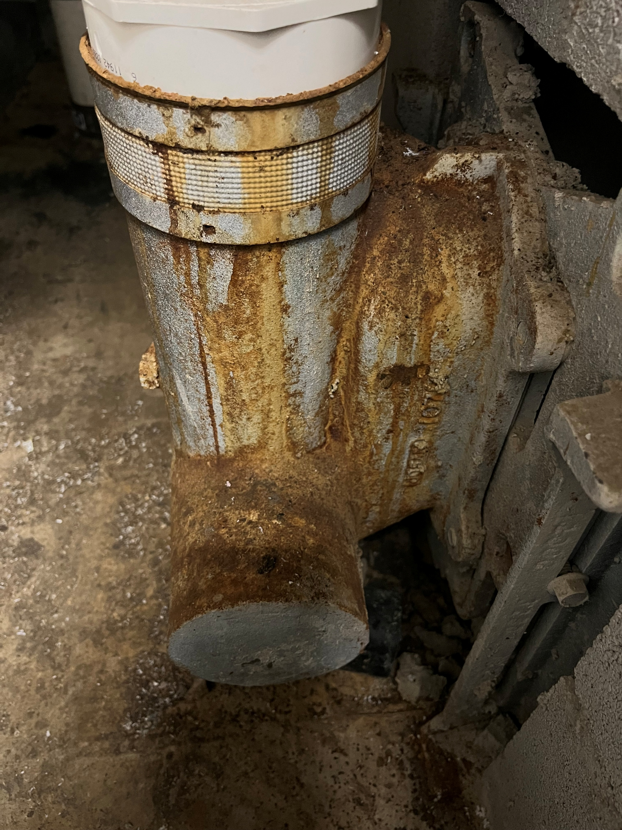
PLUMBING
Aging plumbing to be replaced / upgraded.

Slide 13
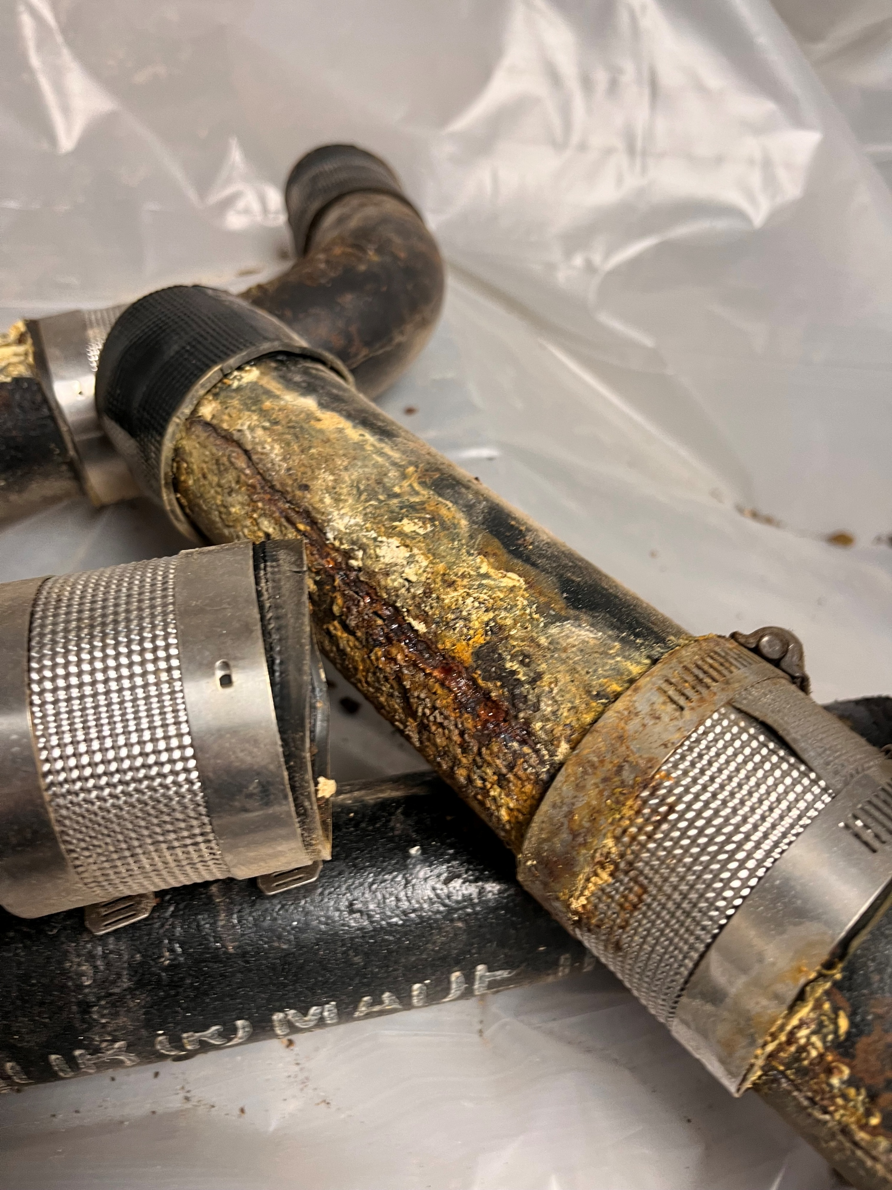
PLUMBING
Aging plumbing to be replaced / upgraded.

Slide 14
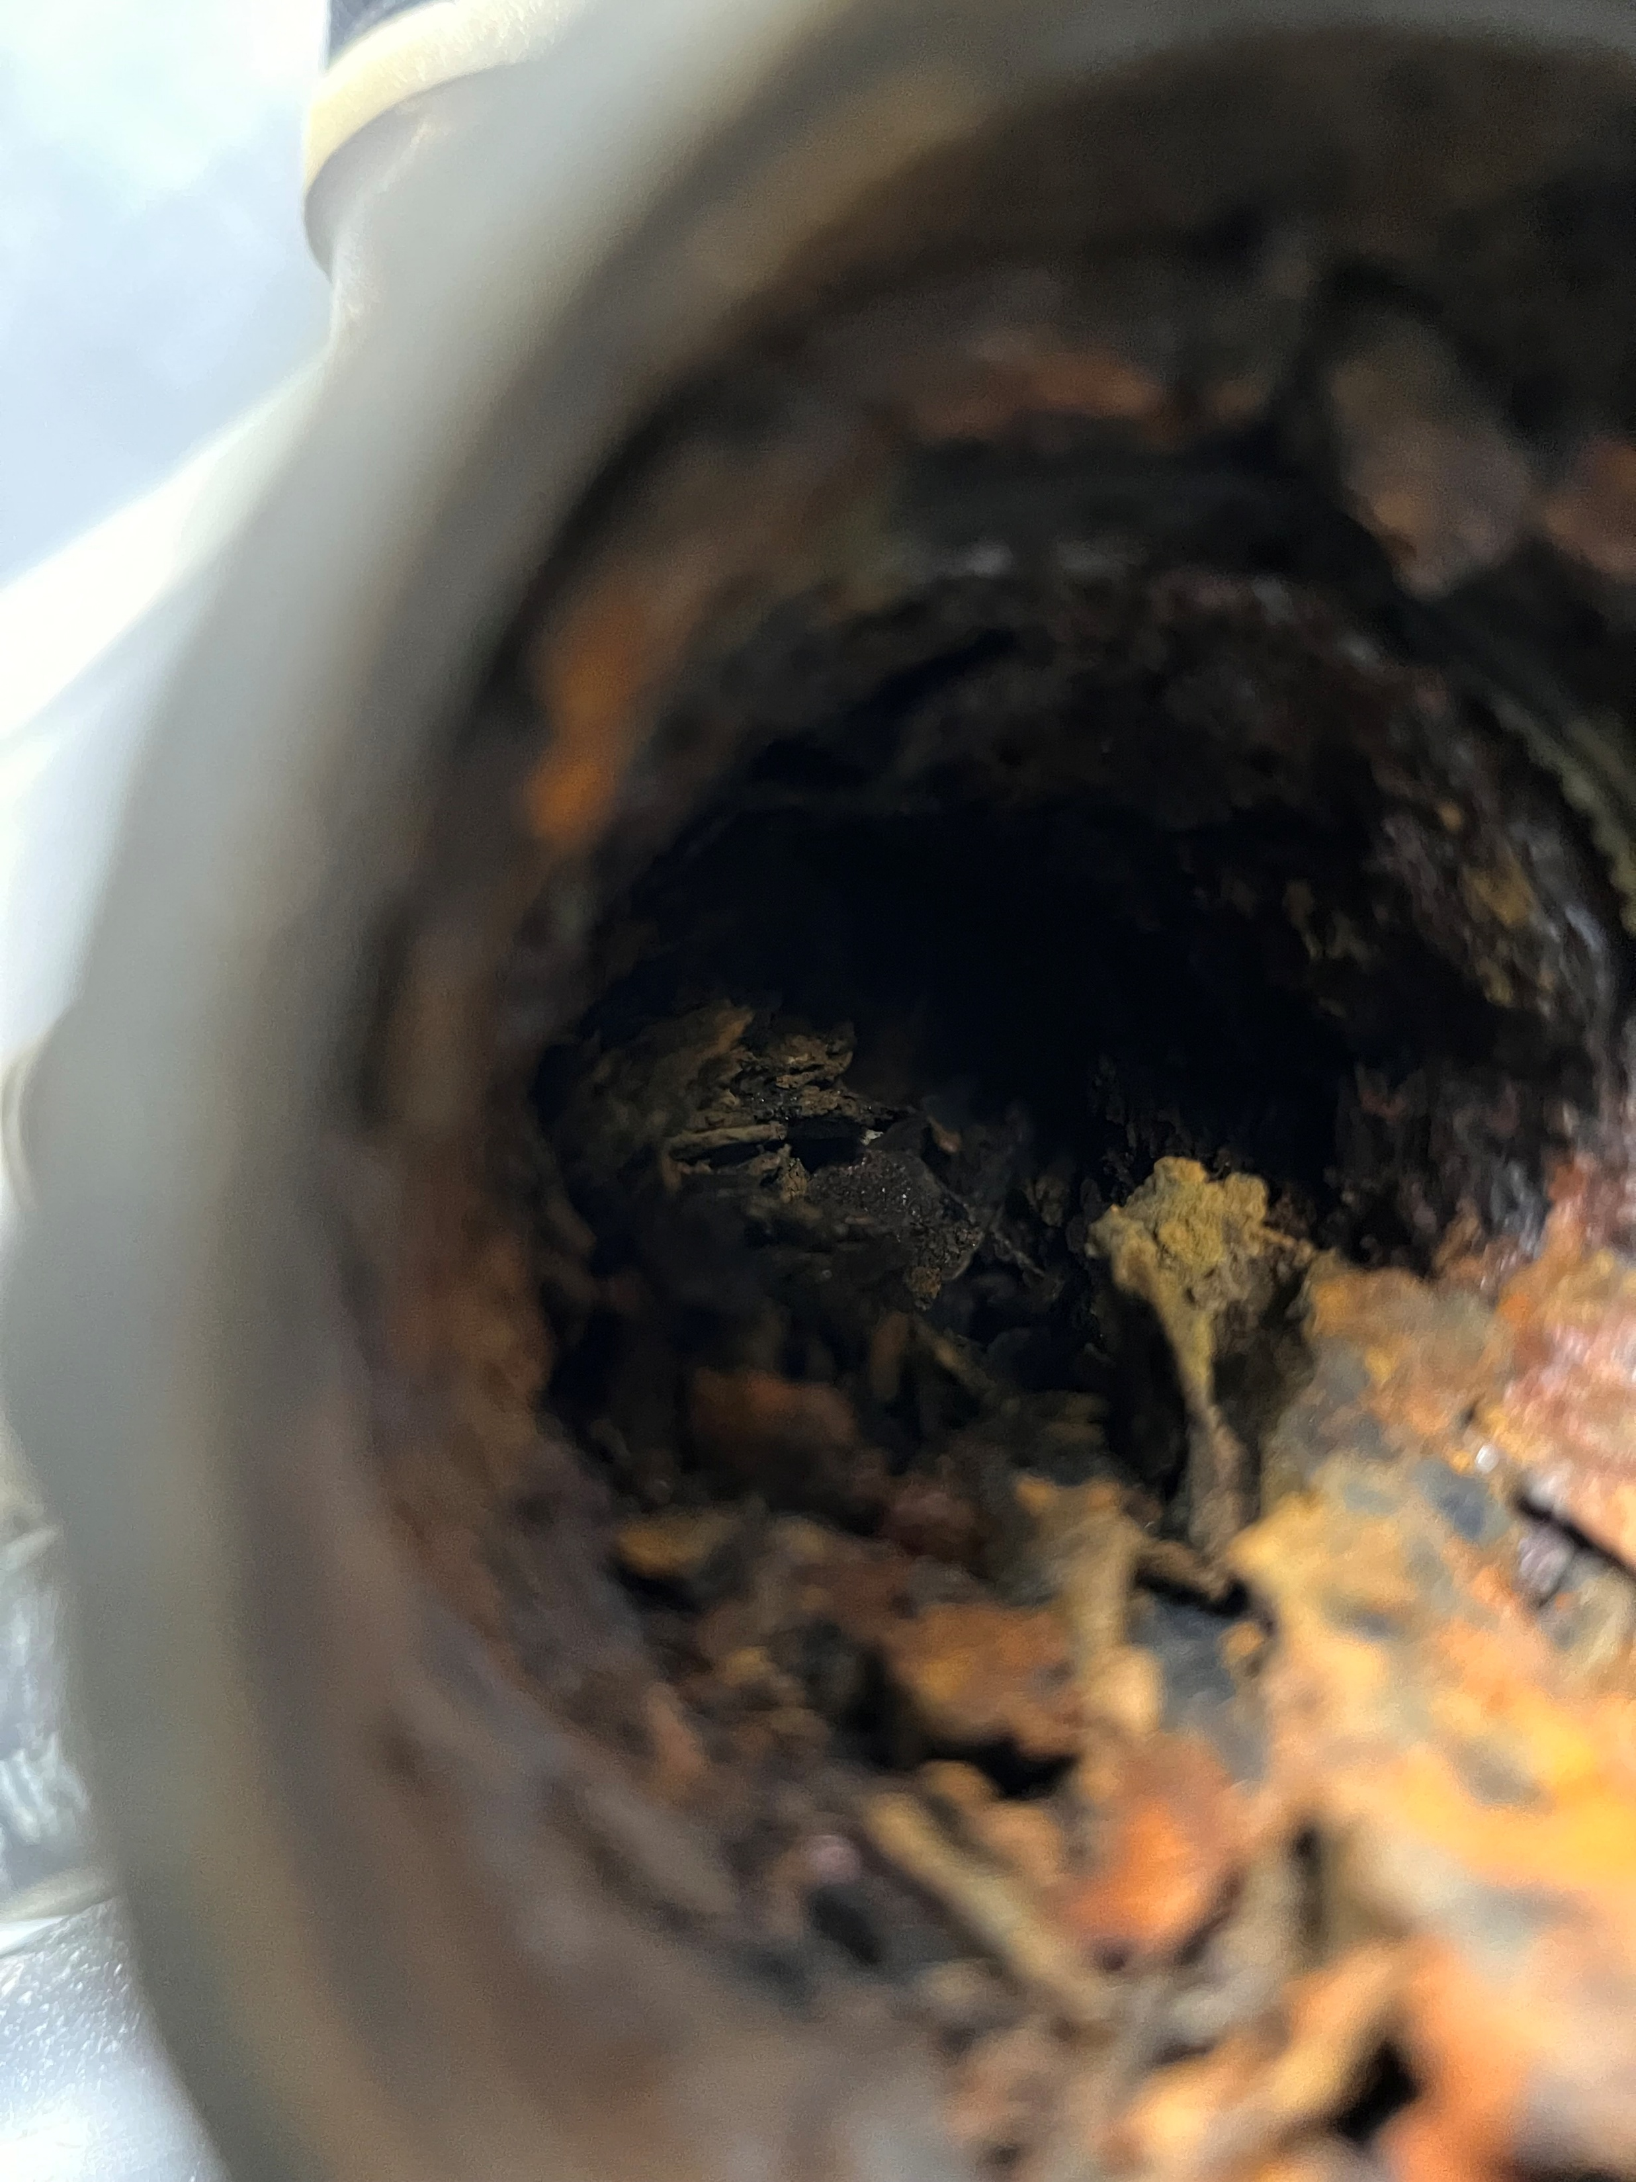
PLUMBING
Aging plumbing to be replaced / upgraded.

Slide 15
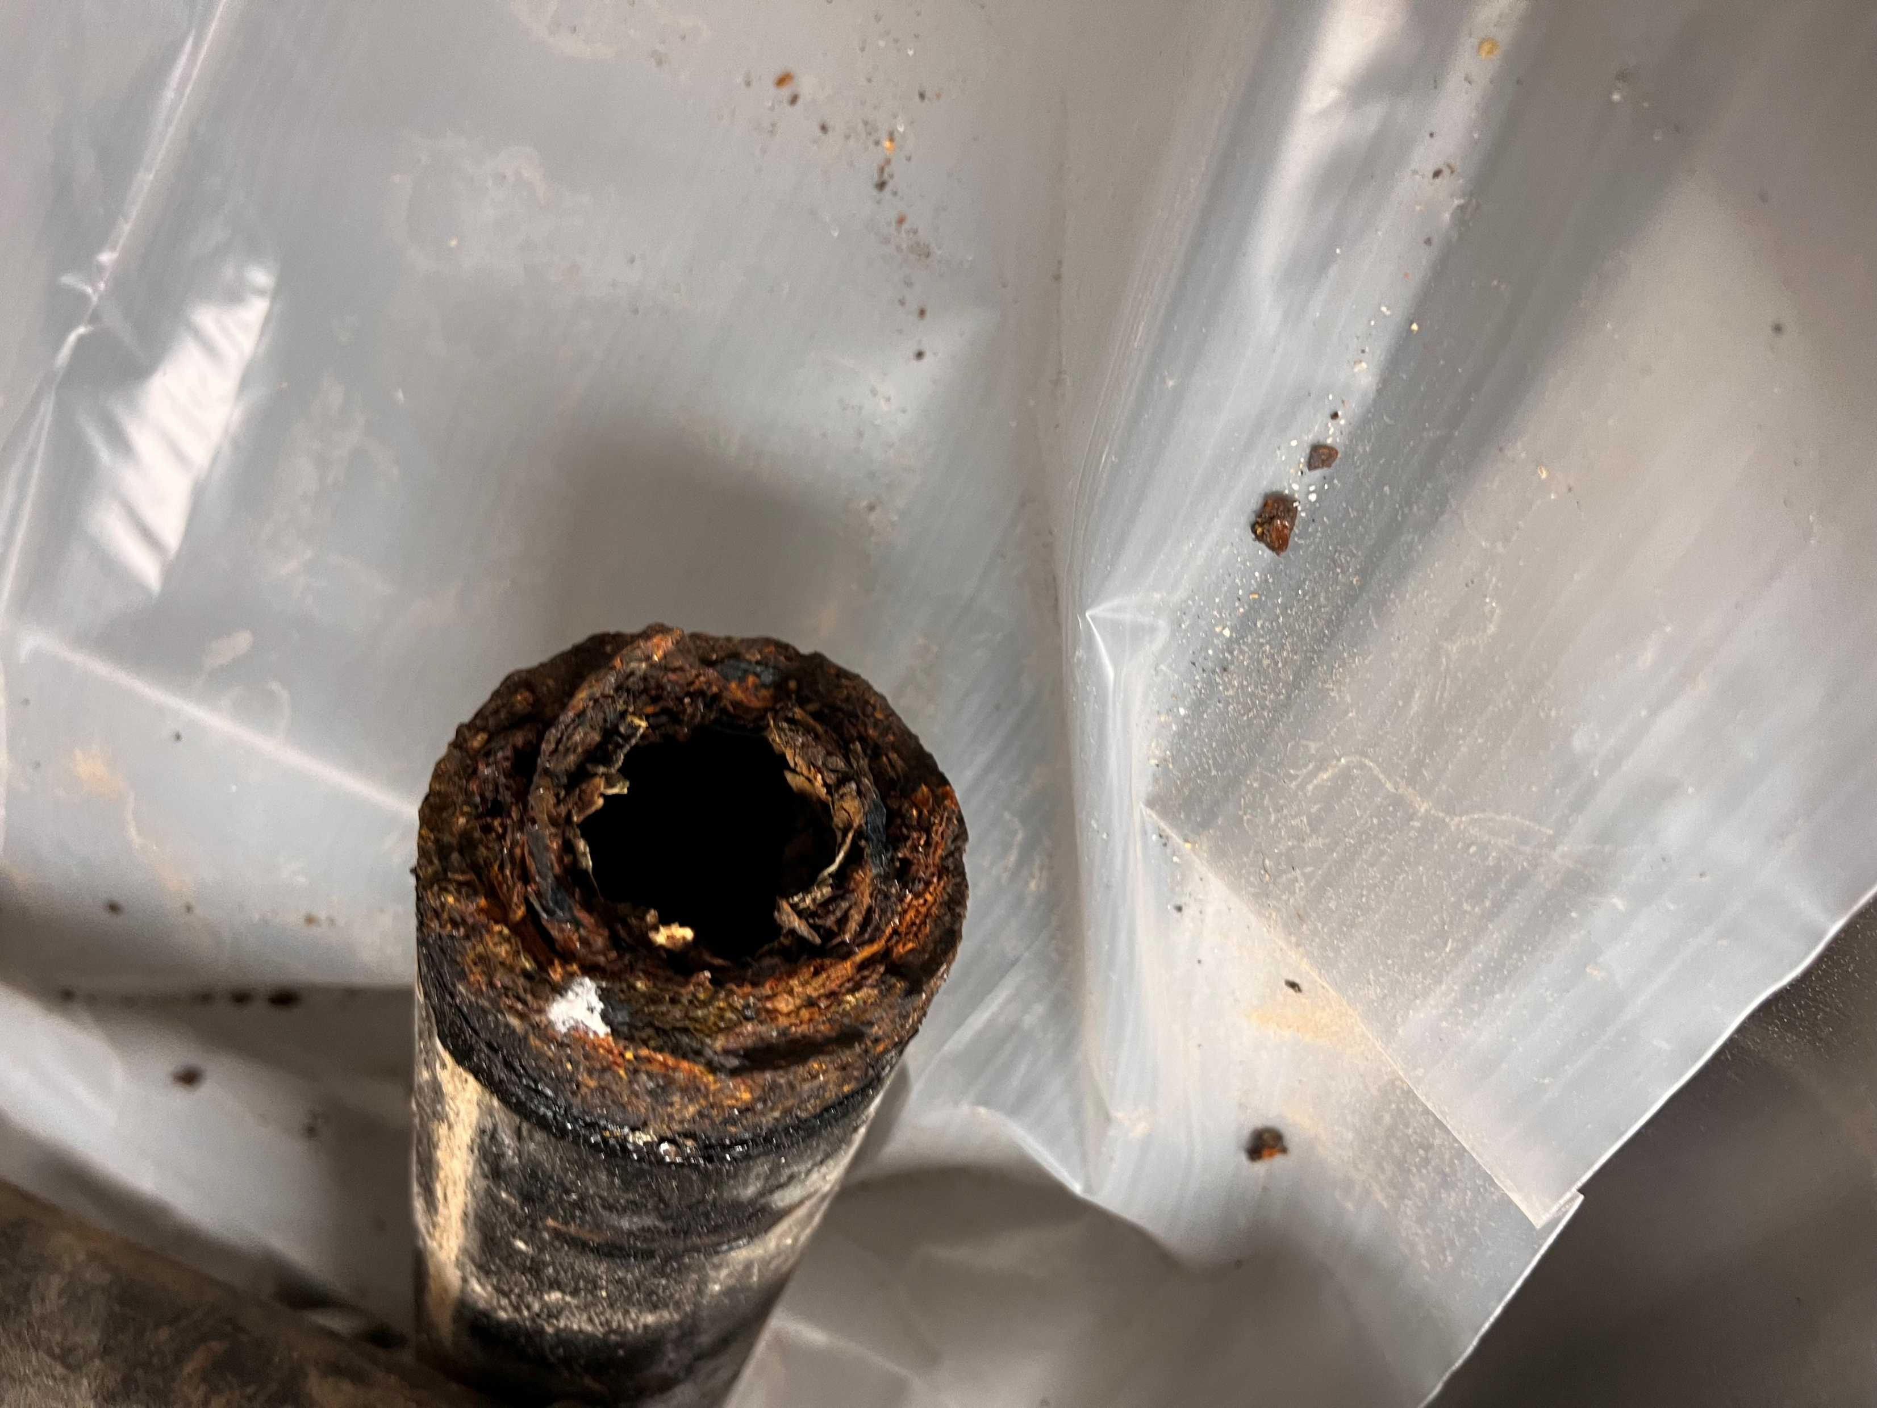
PLUMBING
Aging plumbing to be replaced / upgraded.

Slide 16
FINANCING OVERVIEW
Presented by Specialized Public Finance Inc.

Slide 23
Early Voting begins Tuesday, April 22, 2025
Election Day Saturday, May 3, 2025

Slide 24
Runnels County Jail Repairs / Bond Election
Questions and Answers

Slide 25
Runnels County Jail Repairs / Bond Election
Election Day – Saturday, May 3, 2025

